Slide 1
Node.js Course – 1st Session
Node.js Overview
Leo X Liu
2016.04.28

Slide 2
Agenda
1
Node.js Basic Instruction
2
Node.js Setup
3
Simple HTTP Server
4
Node.js Module
5
NPM
6
Node.js async
7
Node.js debug
8
Exercise

Slide 3
1
Node.js Basic Instruction

Slide 4
1
What is a MEAN stack
MongoDB as the database
Express as the web framework
AngularJS as the frontend framework, and
Node.js as the server platform

Slide 5
2
The advantages of MEAN stack
Support for the MVC pattern
JSON is used for transferring data
Node.js huge module library(200k+)
Open source
Single language is used in the whole application

Slide 6
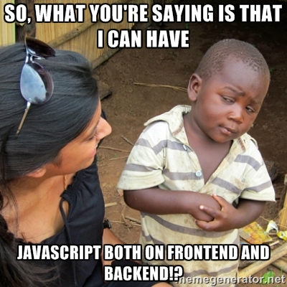

Slide 7
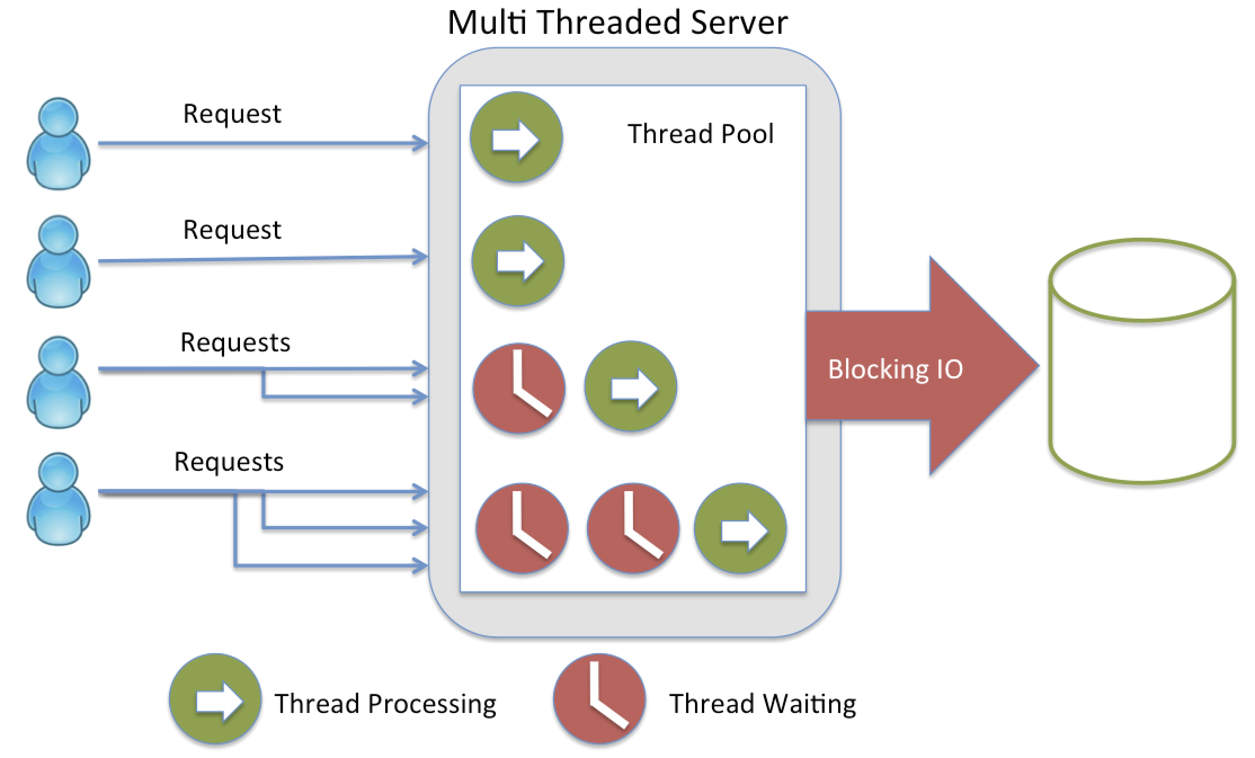
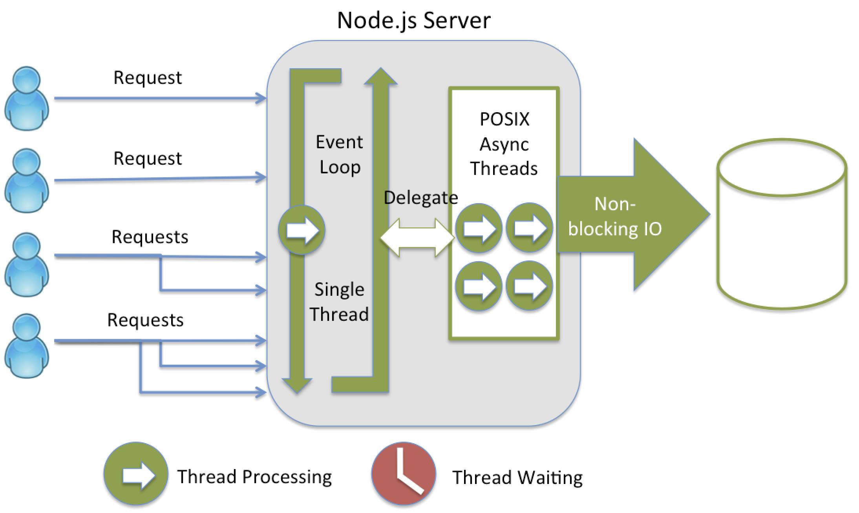
3
Node.js server VS traditional server

Slide 8
2
Node.js Setup

Slide 9
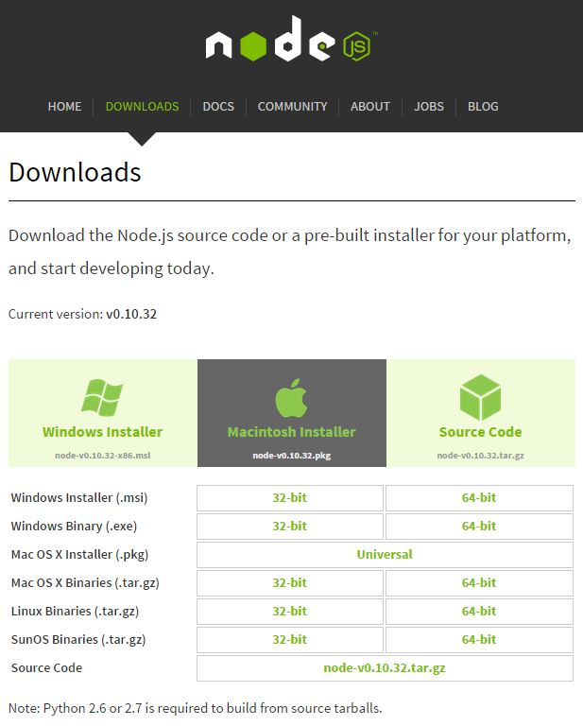
1
How to start Node.js journey
Install related OS version of Node.js from http://nodejs.org/

Slide 10

2
How to start Node.js journey
After installation, add Node.js installation path to Windows Environment Variable Path
Open your CMD in Windows, check installation is ok
Now, we can start run JavaScript in REPL
Notes:
Show in windows CMD

Slide 11
3
Simple HTTP Server

Slide 12
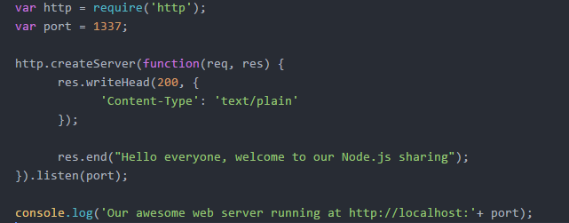
1
Simple HTTP Server

Slide 13
4
Node.js Module

Slide 14
1
Node.js Module
Main Module：scheduling other modules
Binary Module：C/C++; .node & .js
Package：multiple sub modules
Core Modules：events, fs, http
File Modules：express, socket.io

Slide 15
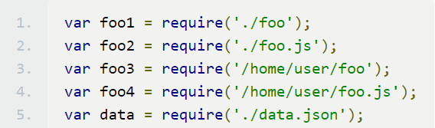
2
Node.js require
Core Modules
var http = require(‘http’);
File Modules
$ npm install express

Slide 16
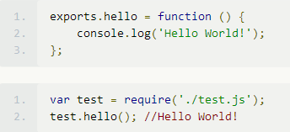
3
exports & module.exports
Exports is the export object of the current module
Public properties and methods

Slide 17
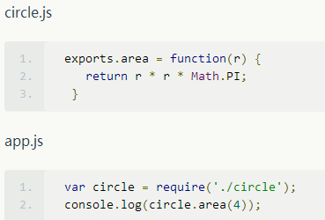
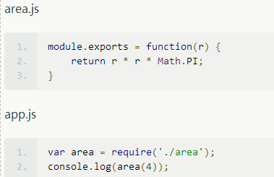
3
exports & module.exports
exports = module.exports = {};
exports = function(r){…}?

Slide 18
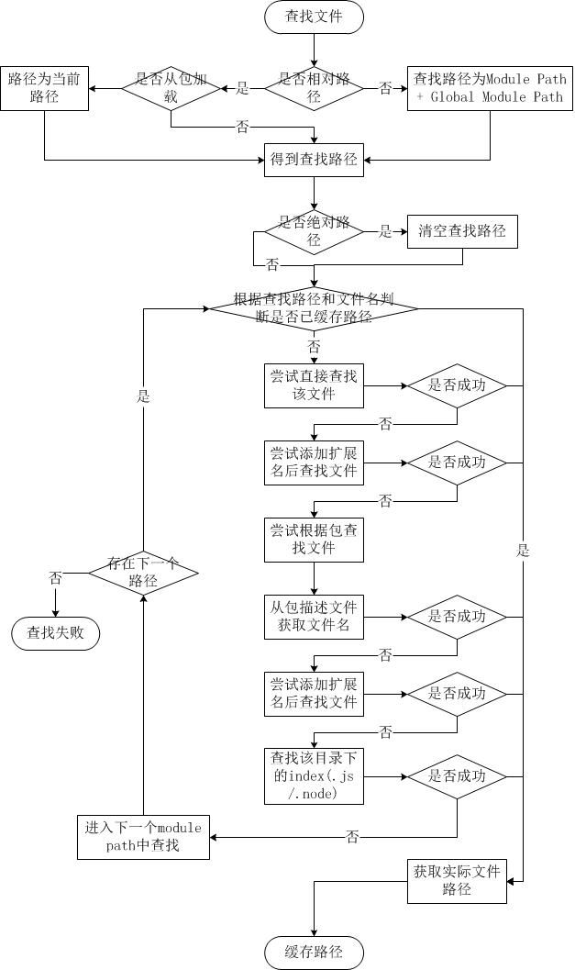
4
Node Module—Find File Strategy

Slide 19
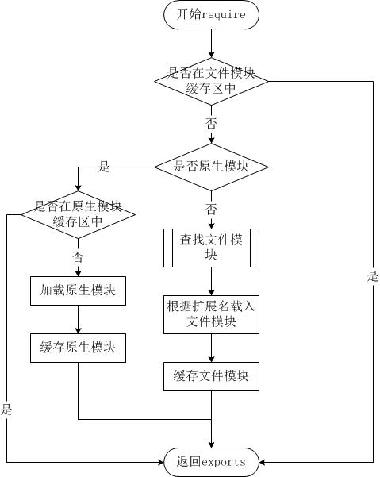
5
Node Module—Load Module

Slide 20
6
Node Module
Module compilation
Node.js will package the JavaScript with below code
(function (exports, require, module, __filename, __dirname) { // in the head
// your code
}); // in the end
Variable scope isolation between module files
Independent of each other

Slide 21
5
NPM – Node.js Package Management

Slide 22

1
NPM
Node.js Package Management will provide a solution to manage your third-party library, like Maven
When your install Node.js, NPM is built-in installed.

Slide 23
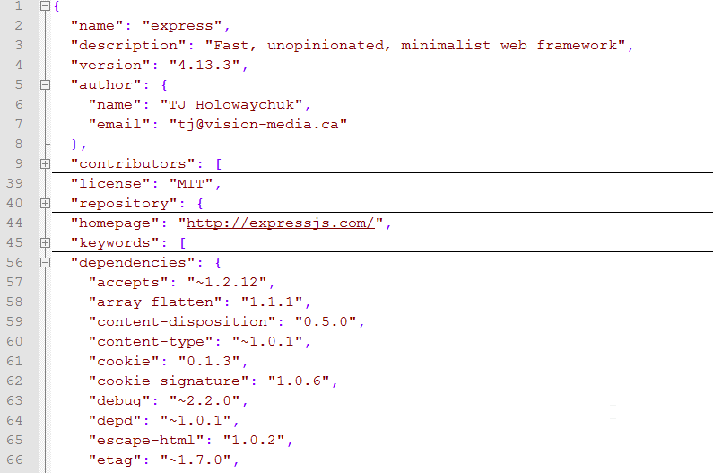
2
package.json
package.json file is located at the root path of project and described project information, include below
Project name
Project owner
Project license
Project dependencies
Customized commands
……
Sample express/package.json

Slide 24
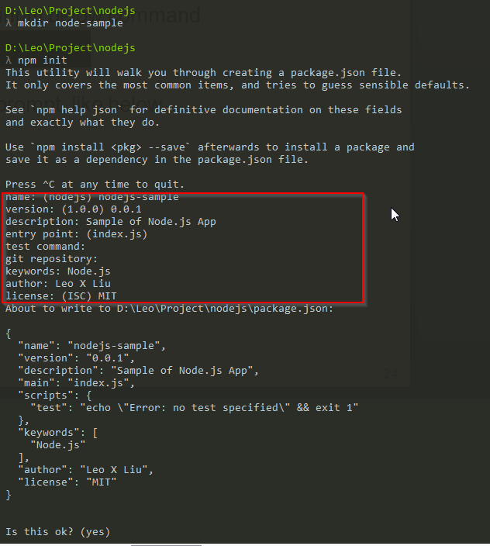
3
Use NPM Create a Node.js Project
In Windows CMD, input below command
Input based on its prompt, like below
After initialization is done, input below command to install dependencies (--save will add the dependency in package.json file automatically)
$ npm init
$ npm install --save <package name>

Slide 25
6
Node.js async

Slide 26
1
Node.js async
Node.js runs on a single threaded event loop and leverages asynchronous calls for various things, like I/O operations.
So many Node.js API is using “callback”, like “fs” module
Notes:
http://justinklemm.com/node-js-async-tutorial/

Slide 27

2
Node.js async
What does “callback” mean?
fs.readFile(“./test.txt”, callback_function);
Means: when the “text.txt” file is finished reading, Node.js event loop will call the “callback_function” to process the pre-defined logic, and it will embedded 2 parameters (err, data) to this function.

Slide 28
6
Node.js debug

Slide 29
1
Node-inspector
Install
$ npm install node-inspector -g
Failed：
Visual Studio c++ 2010
Windows 7 64bit SDK
Python 2.7.x

Slide 30
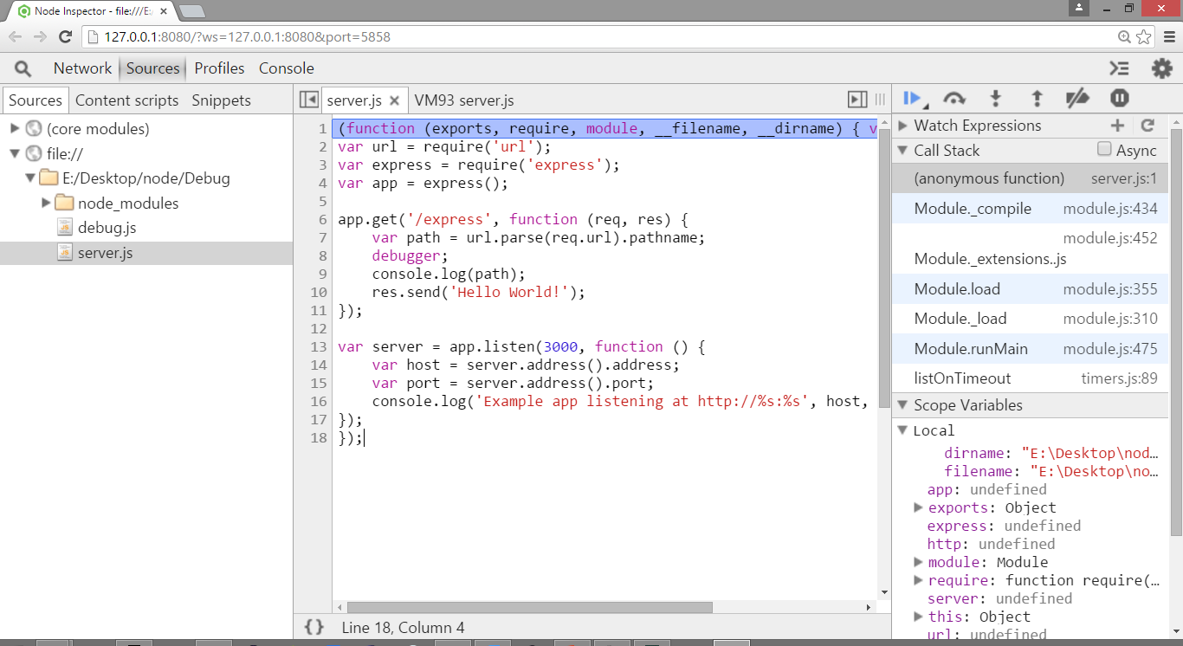
2
Node-inspector
Start Node.js app by node-inspector
Chrome debugger is open automatically with below URL
http://127.0.0.1:8080/?ws=127.0.0.1:8080&port=5858
$ node-debug server.js

Slide 31
7
Exercise

Slide 32
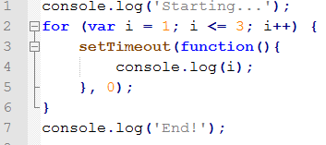
1
Exercise
Write a HTTP Server, print out “Hello Node.js”, and listen 9999 port
Read a file and print out in the console
Move a file to another place
What is the result of below codes?

Slide 33
8
Reference
https://nodejs.org/dist/latest-v4.x/docs/api/
http://nodeschool.io/

